Slide 1
Advanced Programming
Unit 3: Scala

Slide 2
What is Scala?
Scala is a modern general-purpose programming language
Created by Martin Odersky, first appeared in 2004
Supported by Lightbend (formerly Typesafe)
Name is short for “scalable language", designed to grow with the demands of its users
Strong, static typing, like Java, but with type inference
Strong support for both OO and functional programming models – will allow you to learn and practice functional programming techniques
Source code compiles to Java bytecode for execution on the JVM
Can be used in compiled mode, or interactive (“interpreted” - REPL, scripts)
Strong support for concurrency – another motivation to use it here

Slide 3
Working with Scala
REPL
Run scala command at command prompt to start REPL and get scala> prompt
Type Scala expressions or statements at scala> command prompt, evaluated/executed immediately
Scripts
Scala code in script file, run from command prompt, e.g. scala myscript.scala
Compile
Compile using scalac command at command prompt, run compiled code with scala command
IDE
Scala IDE – based on Eclipse
IntelliJ IDEA – with Scala plug-in
IDEs provide
Scala Worksheets – “REPL session on steroids”
Projects – full applications, can have multiple classes, libraries

Slide 4
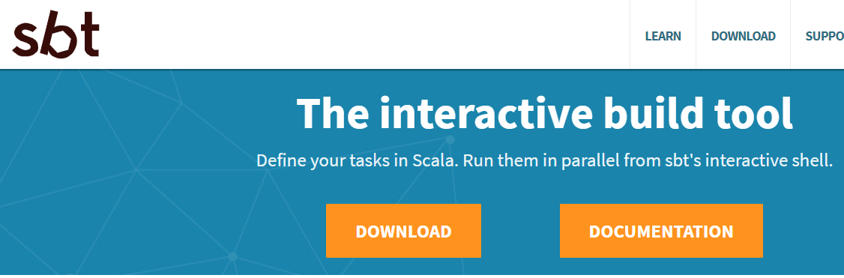
Working with Scala (cont.)
sbt
Build tool, defines application sources, dependencies, output, etc in build file
Build files written in Scala using a DSL (will see more of these later in module)
Can build projects interactively at command line, without an IDE
Similar to Maven, Ant which are commonly used with Java

Slide 5
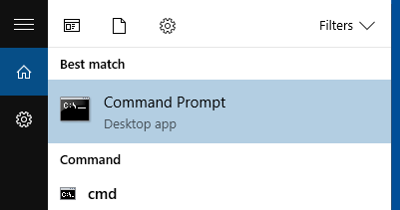
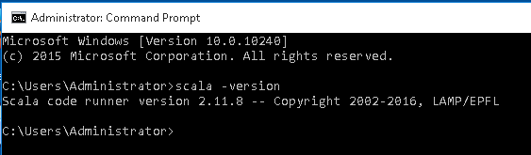
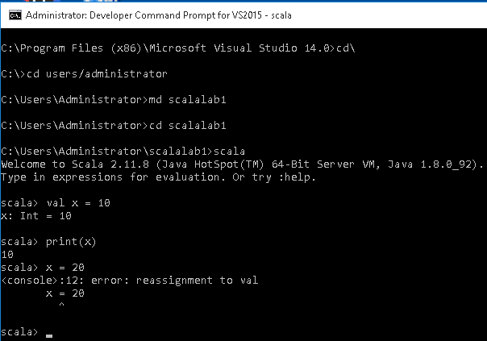
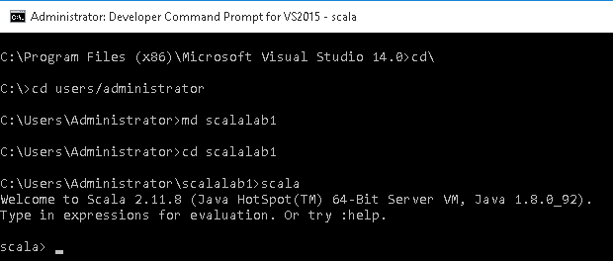
REPL

Slide 6
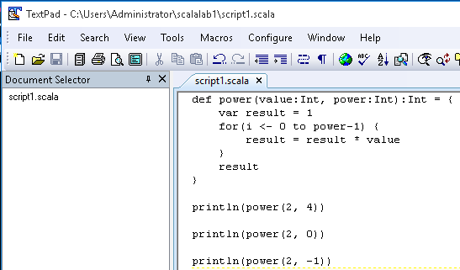

Scripts

Slide 7
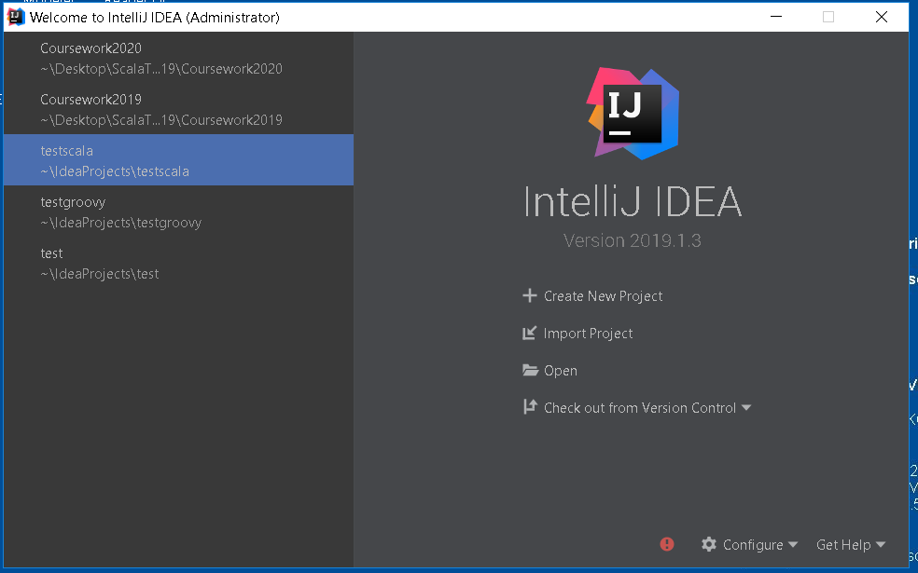
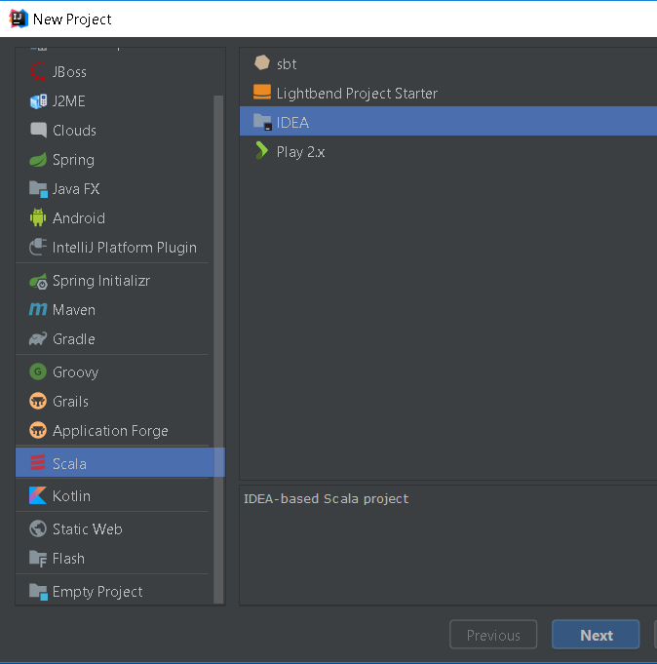
IDE - IntelliJ

Slide 8
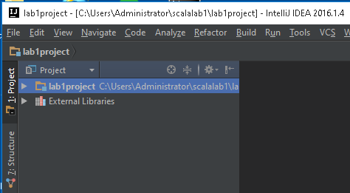
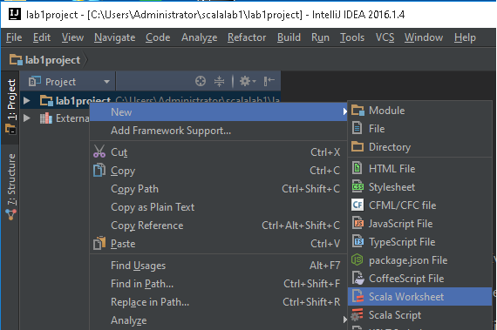
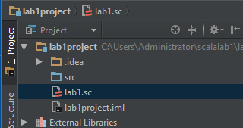
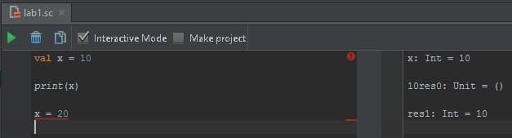
IDE – IntelliJ Worksheet

Slide 9
Expressions and statements
Java
Expression is something that can be evaluated, e.g. 2 + 3
Statement is something that can be executed, e.g. y = 2 + 3;
Scala
Has expressions and statements, but many things that would be statements in Java are expressions, result shown when executed in REPL
scala> val y = 2+3 y: Int = 5
Examples include:
Assignment
if
Loops
Function definitions
…
Colour coding used here to differentiate between input to and output from REPL, you don’t actually see colours in the REPL

Slide 10
Immutable values
Java
Variables can be declared with additional key word final, values can’t be changed
Can be useful, e.g. to define named constants, but work with mutable variables mostly – value can be changed after it is initially assigned
Scala
Variables declared with either val or var keywords
val name = “Jim”: String (may omit type if it can be inferred) var age = 21: Int
val makes a variable immutable, var makes it mutable
As you will see, functional programming style prefers immutability, so it is usual to use val unless there is a good reason to have a mutable variable
Scala supports (and encourages) functional style, but doesn’t enforce it

Slide 11
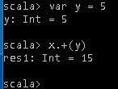
Operators
Java
Has primitive types and object types
Operators are special symbols that perform specific operations on operands, and then return a result
e.g + is a binary operator that (among other things) performs addition on two numeric operands
Not valid if operands are objects unless they are instances of the type wrapper classes (e.g. Integer), in which case compiler ensures these are converted to corresponding primitive at runtime
Scala
No primitive types, everything is an object (Scala has classes and objects, like Java)
Has value types, e.g. Int, but these are classes, not primitives
Operators are nothing special, they are just methods
+ is just a method of the class Int
3.+(4) adds two Ints by called the + method of one and passing the other as a parameter
Infix notation allows this to be written as 3 + 4
Any method that takes one parameter can be used as an “operator” using this notation

Slide 12
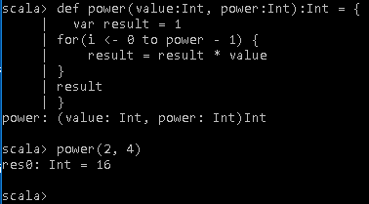
Functions
Java
“Functions” can only be defined as methods in a class
Scala
Functions can be defined as methods in a class, but can also be defined outside a class (there’s more to functional programming than this, though!)
Can enter and call a function in the REPL
Syntax for parameters, returns rather like Java syntax “reversed”
Returns last expression evaluated, don’t need return statement
scala> def square(n:Int): Int = { | n*n | } square: (n: Int)Int
scala> square(4) res0: Int = 16
note the “=“ sign before opening {

Slide 13
Default and named parameters (cont.)
Java
Need to provide values for all parameters when calling a method
Need overloaded methods, with different parameter lists, to support calling with “incomplete parameter lists
public int add(int a, int b) { return a + b; }
public int add(int a) { return a + 10; }
int result1 = calculator.add(3,4);
int result2 = calculator.add(3);
calculator is an instance of the class in which these methods are defined
result1 = 7
result2 = 13

Slide 14
Default and named parameters
Scala
Supports default and named parameters in function/method calls
scala> def add(a:Int=5, b:Int=10):Int = {
| a+b
| }
add: (a: Int, b: Int)Int
scala> add(3,4)
res1: Int = 7
scala> add(3)
res2: Int = 13
scala> add(b=4)
res3: Int = 9

Slide 15
Some special types
Java | Scala | Comment on Scala type
Object | Any, ScalaObject | Any is base for all types, Scala has subclasses AnyVal and AnyRef as base classes for value and reference types. ScalaObject derives from AnyRef and is base class for all classes
void | Unit | Unit is a common concept in FP as functions should evaluate to some value Has value (), represents a value that contains no information, rather than no value
 | Nothing | Base type of all others, has no value, only use as return type if function will never return
null | Option – Some[val] or None | Useful in situations where a function may need to return a value or no value depending on the input,

Slide 16
Classes and objects
Java
Source code written as classes
Objects are instances of classes created with new key word
methods and values that aren’t associated with individual instances of a class declared as static
Scala
Source code can be written as classes
Objects are instances of classes created with new key word, or instances of value types such as Int
Can define singleton objects, denoted by using the keyword object instead of class
Unlike instances of classes, there can only be one singleton object of a given type
Singleton objects usually contain methods and values that aren’t associated with individual instances of a class
Sometimes create companion objects for classes

Slide 17
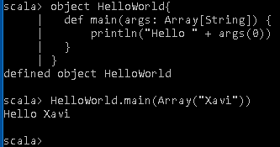
Main method
Java
main method is entry point for a Java application
Declared inside a class, doesn’t matter which class as it doesn’t belong to any object
Static method
Scala
main method is entry point for a Scala application
Declared inside a singleton object
Alternatively, put entry point code inside an object that extends App
object Hello {
def main(args: Array[String]) {
println("Hello, world")
}
}
object Hello extends App {
println("Hello, world")
}
OR

Slide 18
Constructors
Java
Constructor(s) have same name as class
Often used to initialise fields
Scala
Primary constructor is class body, parameters come after class name
Constructor parameter s are fields, val by default but can be declared as var
class Greeter(message: String) { println("A greeter is being instantiated")
def SayHi() = println(message) }
Can have auxiliary constructors, to support different parameter lists, named this, that call the primary constructor
this class has a field called message, a method called SayHi and a line of code that runs as object is created – how many lines would this take in Java?

Slide 19
Getters and setters
Java
Most common access modifiers for fields are public and private
Need to manually create getters and/or setters for private fields (although this is a common refactoring in IDEs)
Scala
Compiler can generate getters/setters, although you can add your own
If a field is declared as a var, compiler generates both getter and setter methods for that field.
If the field is a val, compiler generates only a getter method for it.
If a field doesn’t have a var or val modifier, compiler doesn’t generate a getter or setter method for the field.
Additionally, var and val fields can be modified with the private keyword, which prevents getters and setters from being generated.

Slide 20
Selection
Java
if statement allows path of execution to be selected on the basis of some condition
Scala
if expression allows evaluation to be selected on the basis of some condition
Difference is subtle, but important for functional programming as you will see shortly
Returns a value which is the result of the selected evaluation
scala> val x = 3
x: Int = 3
scala> val result = if(x<0){
| "negative"} else {
| "positive"}
result: String = positive

Slide 21
Selection from multiple options
Java
switch statement
Selects execution path based on a case value
Scala
match expression allows evaluation to be selected on the basis of case
Much more powerful than switch, basis of pattern matching which is important in functional programming
Returns a value which is the result of the selected evaluation
scala> var month = "Feb" month: String = Feb
scala> var season = month match{ | case "Dec"|"Jan"|"Feb" => "winter" | case "Mar"|"Apr"|"May" => "spring" | case "Jun"|"Jul"|"Aug" => "summer" | case "Sep"|"Oct"|"Nov" => "autumn" |} season: String = winter

Slide 22
Arrays and collections
Java
Arrays hold multiple values or objects of the same type
Collections framework contains many library classes for collections of values or objects, each with methods appropriate to the data structure it implements, e.g. ArrayList
Scala
Arrays hold multiple objects of the same type
Collections as in Java, e.g. List, Vector, Map
Distinguish between immutable (never change) and mutable
Default is usually immutable in functional programming
scala> var z:Array[String] = new Array[String](3)
z: Array[String] = Array(null, null, null)
Scala> z(0) = "Hello"; z(1) = "Bonjour"; z(2) = "Hei"
scala> var z = Array("Hello","Bonjour","Hei")
z: Array[String] = Array(Hello, Bonjour, Hei)
scala> val z:List[String] = List("Hello","Bonjour","Hei")
z: List[String] = List(Hello, Bonjour, Hei)

Slide 23
Iteration
Java
while loop, for loop, enhanced for loop
Scala
While loop, for loop
But, you will see later that loops are used much less commonly in functional programming than in imperative programming
For expressions iterate through a collection and evaluate an expression for each member – yield each and collect results
Many data structure classes have foreach method that applies a function to each member in turn
scala> for (i <- 1 to 10 if i % 2 == 0) | yield i
res0: scala.collection.immutable. IndexedSeq[Int]0 = Vector(2, 4, 6, 8, 10)
scala> val x = List(1,2,3) x: List[Int] = List(1, 2, 3) scala> x.foreach { println } 1 2 3

Slide 24
Inheritance
Java
Single inheritance, a class can be a subclass of one superclass
A class can implement multiple interfaces, needs to implement methods declared in each one
(In Java 8, though, interfaces can contain implementations of default (or defender) methods)
Scala
A class can be a subclass of one superclass
Multiple inheritance supported by traits
Traits are like interfaces but implement methods
A class can extend a trait and “mix-in” other traits
Will look at this in detail later

Slide 25
Reference
There are many useful sources of reference material to help you when you are working with Scala., including the following material on the official Scala website:
http://docs.scala-lang.org/tutorials/ - a tour of the essentials
http://docs.scala-lang.org/overviews/ - a collection of usefule guides and overviews
http://www.scala-lang.org/api/current/ - API documentation, similar to the Java API documentation
Also, the book Programming in Scala by Odersky, Spoon & Venners is an authoritative source, as it is co-written by the designer of the language

Slide 26
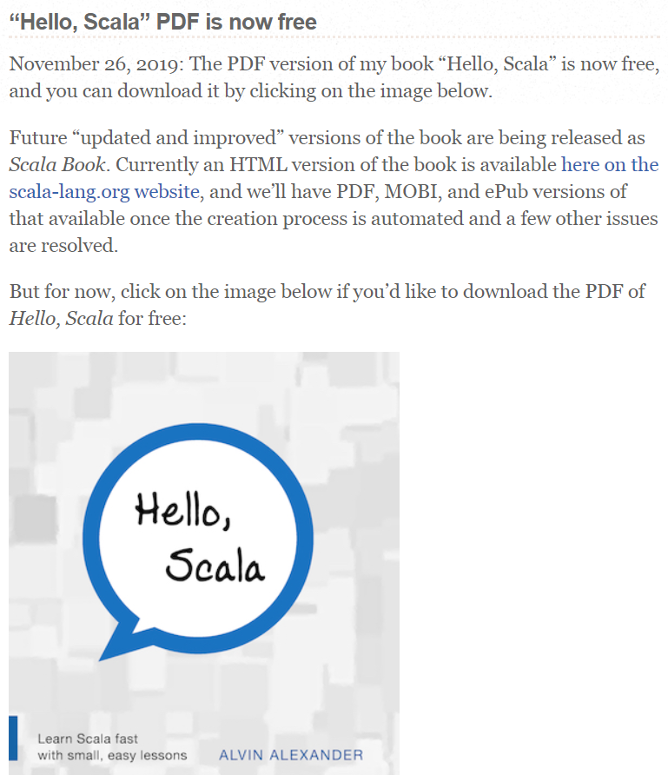
Free Scala Book
alvinalexander.com

Slide 27
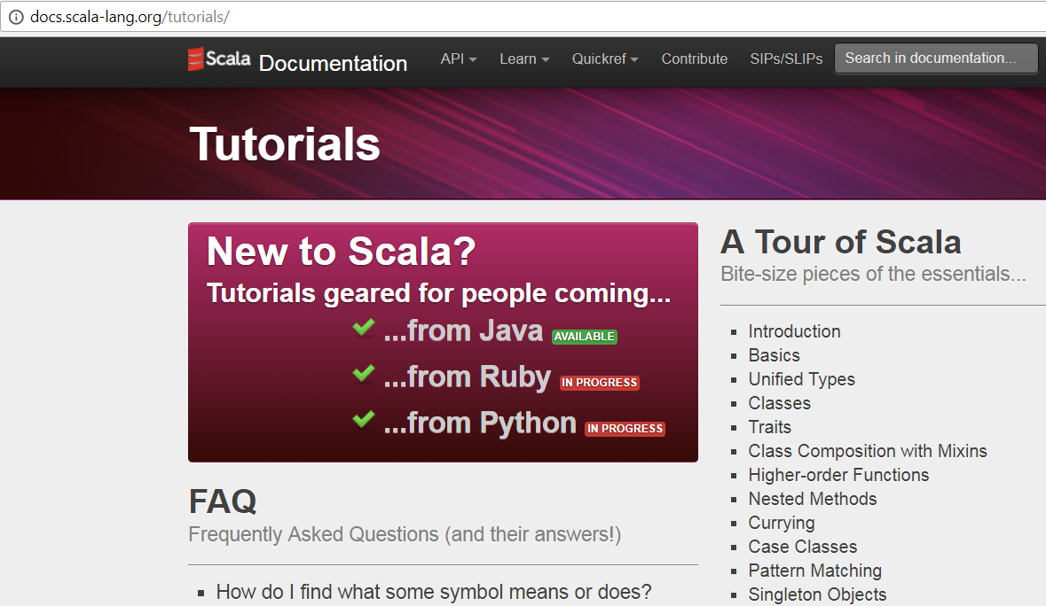
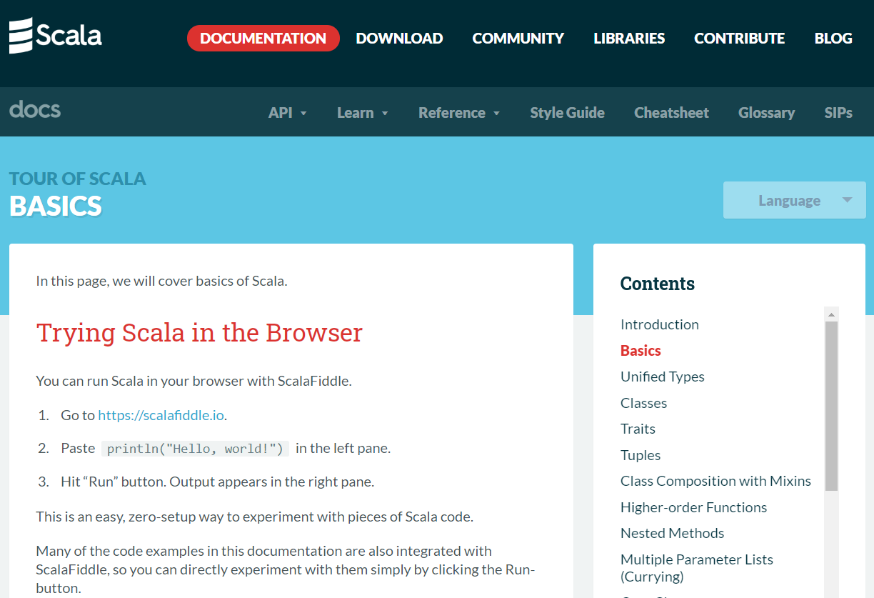
Scala Tutorial

Slide 28
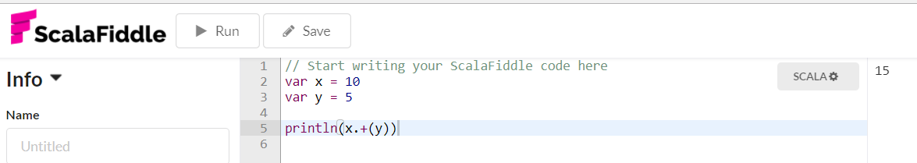
ScalaFiddle

Slide 29
Summary
Scala is an OO language that compiles to JVM bytecode
Similar to Java in some respects, some differences are relatively small and result in more compact code
Significant differences provide support for functional programming style:
Type system
Functions
Focus on expressions rather than statements
Powerful features for pattern matching and iteration
Next you will learn some principles of functional programming with the help of examples in Scala

